Slide 1
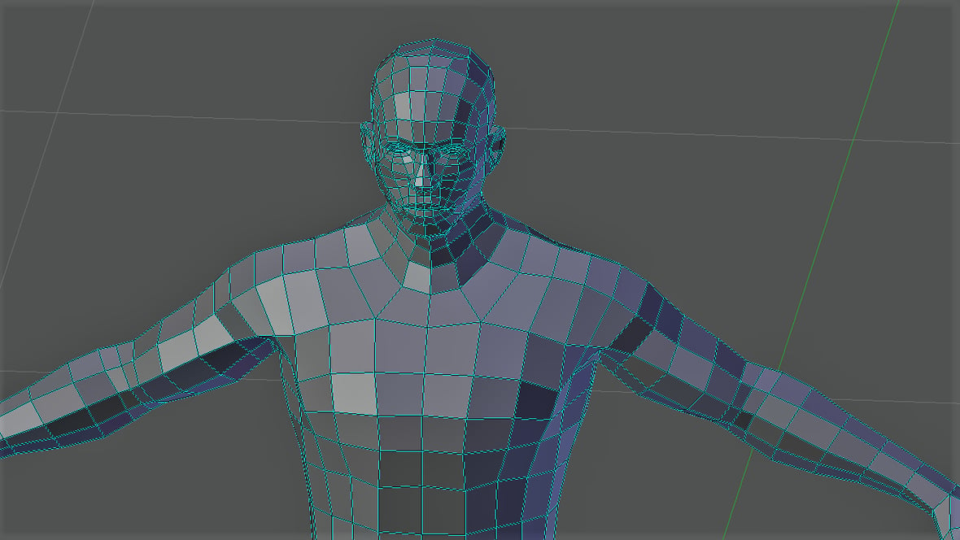
Building a Modular 3D Human
Model using Game Engine​

Slide 2

Work-let Name: Building Modular 3D Human Model using Game Engine
Worklet Details
Worklet ID: RSG26IIITK
College Name: IIITDM, Kurnool
.
KPIs achieved till now
I . Imported a 3D models and explored by adding lights to the surface and by rotating in various directions and different views.
II . Observed the variations in skin colour and clothes they wear
Any Challenges/ Issues faced
While adding the light on the surface the size of the light should be larger than the model that is present on the surface.
Next Steps
We will try to improve the camera visuals dynamically.
Key Achievements/ Outcome till now
Explored about the software
Imported a various 3D human models
and observed the variations in facial structures
Hair styles, skin colour, and clothes they used.
Date: 24-04-2023

Slide 3
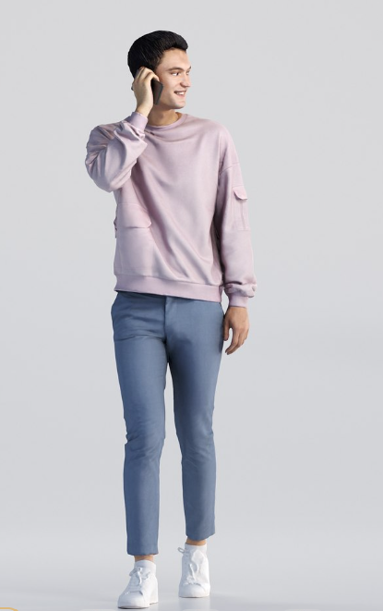
Month 3 Mianly Concentrate on the
Import the 3D model into the software.
Select the modelling mode and start adding light effects to the model and observe the effects of the light on the 3D model ( Hair Facial style, clothes and skin textures ) in different perspectives

Slide 4
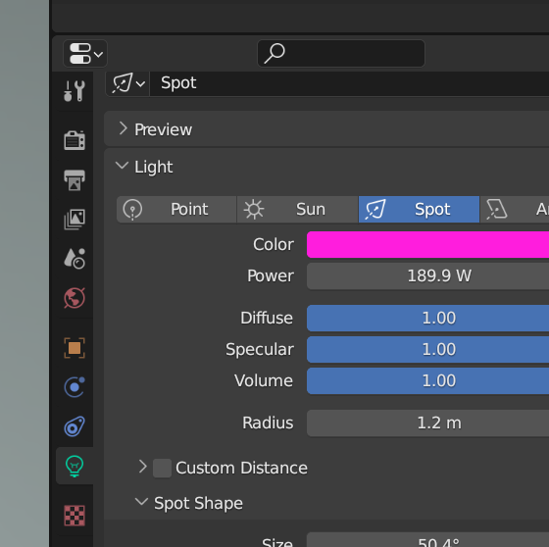
Now By using light we can vary the hair style and entire body by changing with light focus like
Spot light
Sun light
Point Light
Area Light

Slide 5
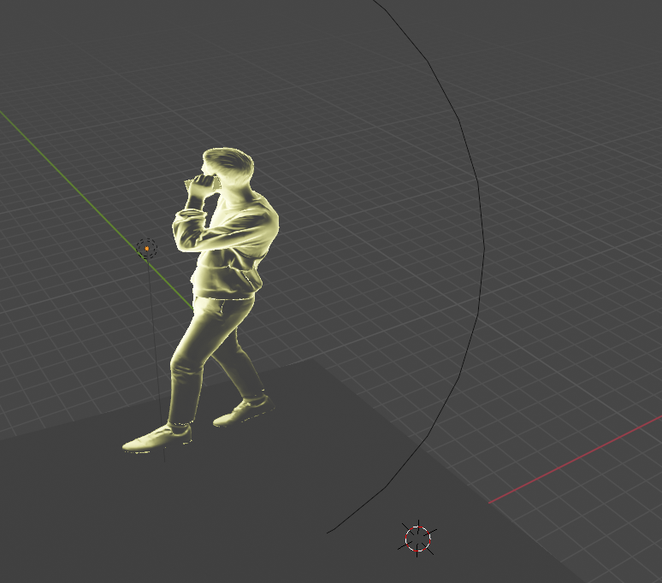
Variation of model under point light:

Slide 6
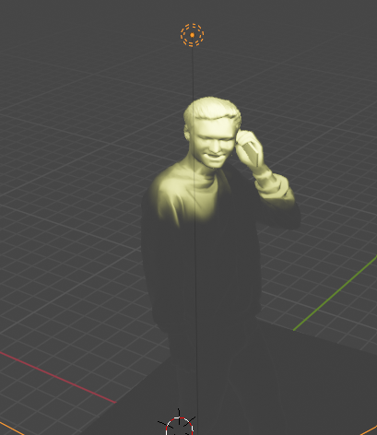
Variation of the facial structures

Slide 7
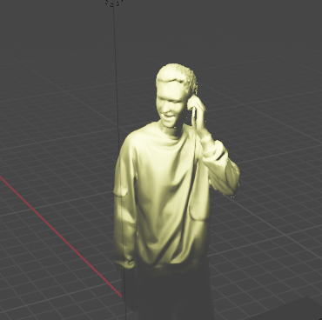
Variation of the Both facial and clothes with the light at different angles
Ex: 69.8 degrees

Slide 8
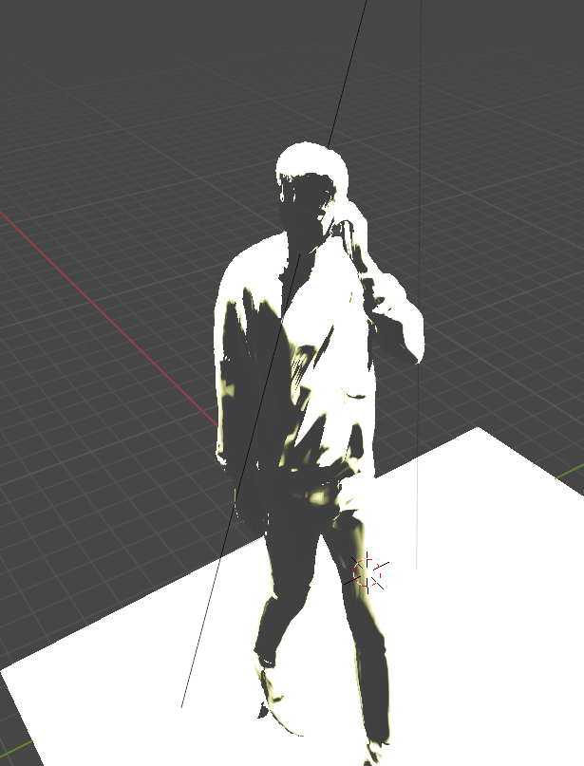
Variations that can be observed under the sun light when light is at back view

Slide 9
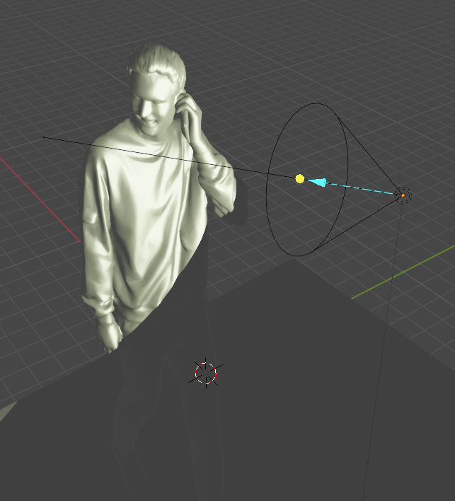
In terms of spot light we can observe the image in different views on adjusting with different angles

Slide 10
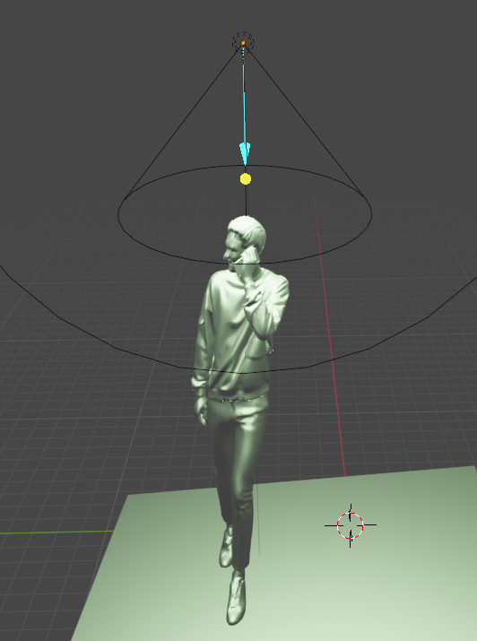
When we are using spot light we have to increase the cone size to focus on the entire model

Slide 11
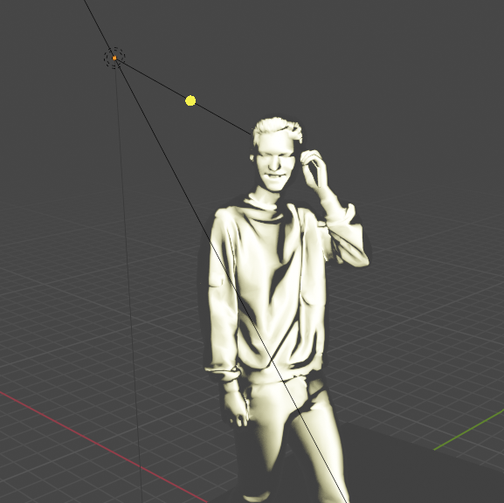
Variations under the Area Light
( Rectangle)

Slide 12
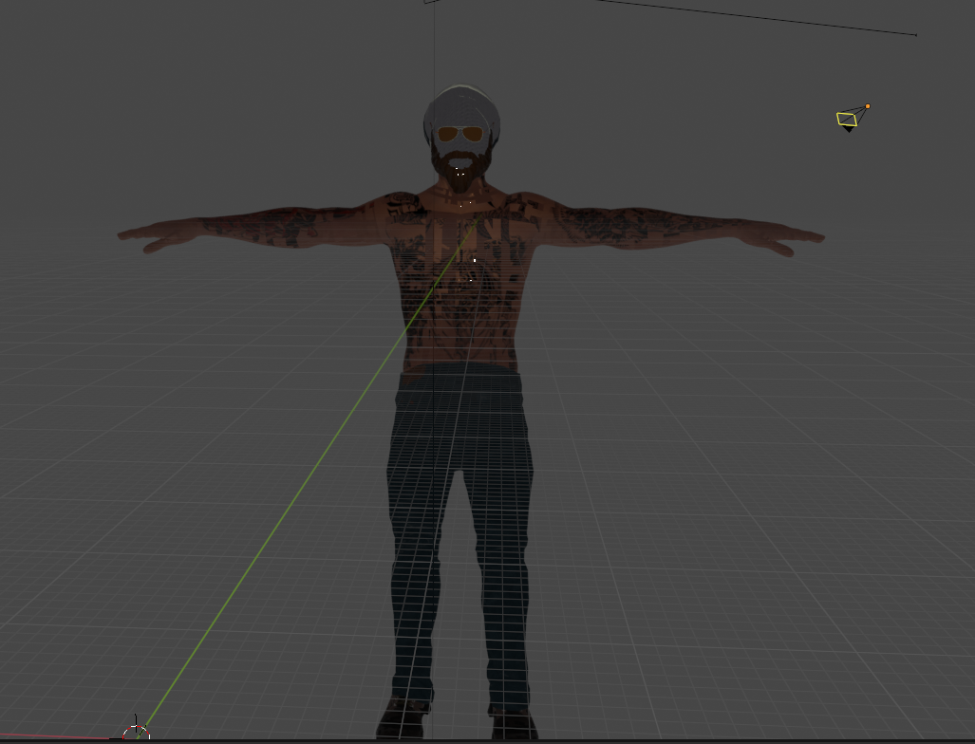
Original Image

Slide 13
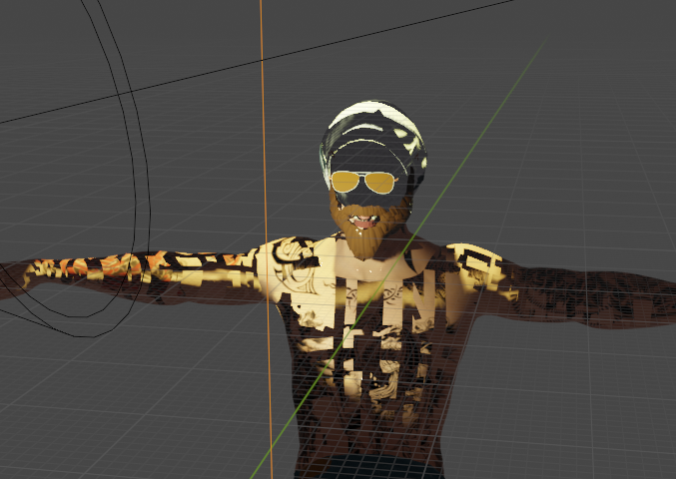
Observe goggles and Beard

Slide 14
Thank You
Mentors:
D.V.L.N Somayajulu
J. Krishnaiah
Students:
P Jagadeesh
G Nagendra Babu
M Deepika

